Slide 1
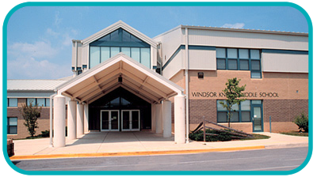
Standards Based Grading at
Windsor Knolls Middle School
“If your grading system doesn't guide students toward excellence, it's time for something completely different.” Patricia L. Scriffiny

Slide 2
What is a “standard?”
Standards are final learning goals or outcomes. Standards can be found in the Curriculum Now database on FCPS.org and focus on National and State College and Career Readiness Standards.
In standards-based grading, students receive a grade for each standard or set of related standards.

Slide 3
Example of an
FCPS 8th Math Standard:
Explain a proof of the Pythagorean Theorem and its converse.

Slide 4
Why Standards-Based Grading?
With standards based grading, grades on Pinnacle will reflect a student’s degree of mastery of specific math standard.
Teachers, parents, and students will be able to see exactly where students are excelling and where they may need additional help.

Slide 5
Why Standards-Based Grading?
Traditional grading can result in grades that are a combination of student behaviors and student performance.
Student #1:
always prepared
pays attention
completes all work
does extra credit
fails tests and quizzes
GRADE IN CLASS: B
Student #2:
comes unprepared
incomplete assignments
missing assignments
tends to be off-task
earns “A”s on tests
GRADE IN CLASS: C
These students have “earned” grades that are not reflective of their levels of content mastery.
Notes:
STET Team feedback:
1. Some departments still have weighted categories. How will we explain the difference to parents when they read this slide?
2. Have you reviewed Christine’s email on the webinar for Standards Based Grading? There’s a great analogy on this that maybe could be used and bring better understanding to parents. See what you think. Maybe we can lift some of those slides. They are really cool!
https://www.bigmarker.com/GlobalMathDept/8July2014

Slide 6
Let’s take a look at SBG,
style!

Slide 7
Angry Birds Standard:
Knock down the green pig using 3 or less angry birds.

Slide 8
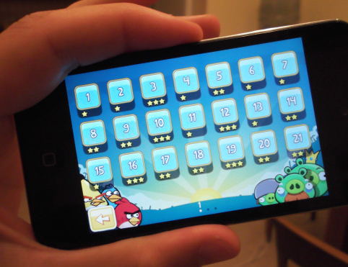
Traditional Grading using Angry Birds
Each level is an assignment
Imagine if you could only play each level once and you were stuck with that score.
Traditional grading focuses on assessment of task rather than concept/standard mastery.

Slide 9
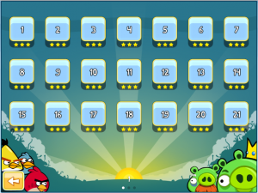
Standards-Based
using Angry Birds
Each level is a standard, not a task.
You are allowed to go back and play each level until you master it.
The focus is on concept/standard mastery

Slide 10
Scale
Comparison:
STANDARDS-BASED
GRADING SCALE
100% | A | Advanced Mastery
85% | B | Essential Mastery
75% | C | Basic Mastery
65% | D | Limited Mastery
55% | F | No Mastery
50% | F | No Attempt
90 - 100% | A
80 - 89% | B
70 - 79% | C
60 - 69% | D
59% & below | F
TRADITIONAL
GRADING SCALE
There are NO zeros when using SBG.

Slide 11
Two zeros requires
8 grades of 75%
to raise the
grade to a 60%!

Slide 12
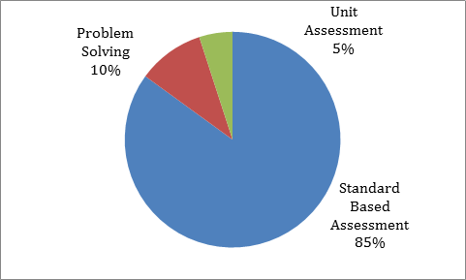
Pinnacle Categories for Math
75%

Slide 13
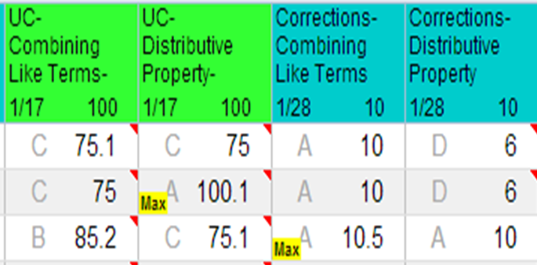
How do you read Pinnacle?
Student #1
•Has made corrections and taken one retest for Combining Like Terms.
•Has attempted corrections for Distributive Property but hasn’t taken the retest

Slide 14
Student #2
•Has made corrections and is ready to take a retest for Combining Like Terms.
•Has made corrections and taken a retest for Distributive Property.

Slide 15
Student #3
•Has made corrections and two retests for Combining Like Terms.
•Has made corrections for Distributive Property and taken one retest.

Slide 16
How will I use the information from Pinnacle?
•Who needs reteaching? (either in class or through ELT tutoring).
•What portion of the class needs reteaching?
•Who needs enrichment?
•Who is ready for reassessment?

Slide 17
You will see comments about a student’s strengths or weaknesses in that concept.

Slide 18
8th Grade Math Units
TERM 1 | TERM 2
Pythagorean Theorem Input-Output Relationships Linear Functions (10 standards) | Expressions and Equations Formulating and Solving Linear Functions (5 standards)
TERM 3 | TERM 4
Transformations Working with Exponents (10 standards) | Volume Radicals and the Real Number System Statistics and Probability (8 standards)

Slide 19
8th Grade Common Core Algebra Units
TERM 1 | TERM 2
Representing Functions Mathematically Linear Functions (25 standards) | Statistics Equations and Inequalities Systems of Equations and Inequalities (22 standards)
TERM 3 | TERM 4
Nonlinear Relationships Exponential Functions and Equations Polynomial Expressions and Functions (22 standards) | Graphing Quadratic Functions Modeling and Writing Quadratic Equations (22 standards)

Slide 20
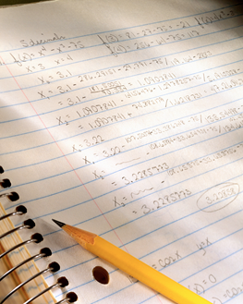
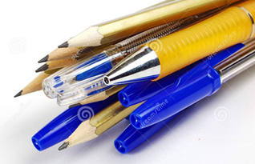
Come prepared to class with:
1 spiral notebook
writing utensils
looseleaf paper
highlighter
2 -pocket folder
OPTIONAL: ruler, tape, markers, colored pencils, scissors

Slide 21
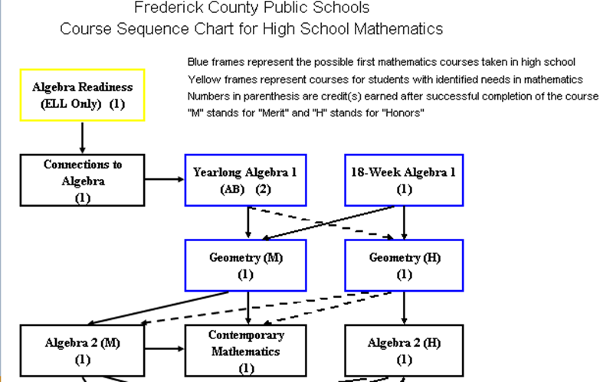

Slide 22
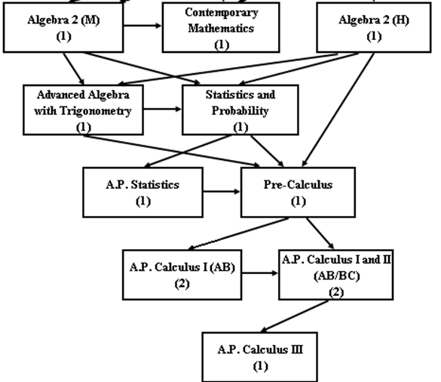

Slide 23
For additional information:
Mrs. Border will have sites on www.edmodo.com and www.toniborder.weebly.com. Students will enroll in the class site during the first week of school. Parents/Guardians who wish to have access need to complete the information form that will be sent home.
classwork
homework
printable documents
websites
games

